Slide 1

ICEG
Open Standards
February, 19th 2020

Slide 2
Agenda
Governance – request for approval Marc Bruyland
URI-standard – request for approval Raf Buyle
URI for enterprises/business units Bart Hanssens
New thematic on Education Thierry Brouwer
Digital Europe for All Marc Bruyland

Slide 3
Agenda
Governance – request for approval Marc Bruyland
URI-standard – request for approval Raf Buyle
URI for enterprises/business units Bart Hanssens
New thematic on Education Thierry Brouwer
Digital Europe for All Marc Bruyland

Slide 4
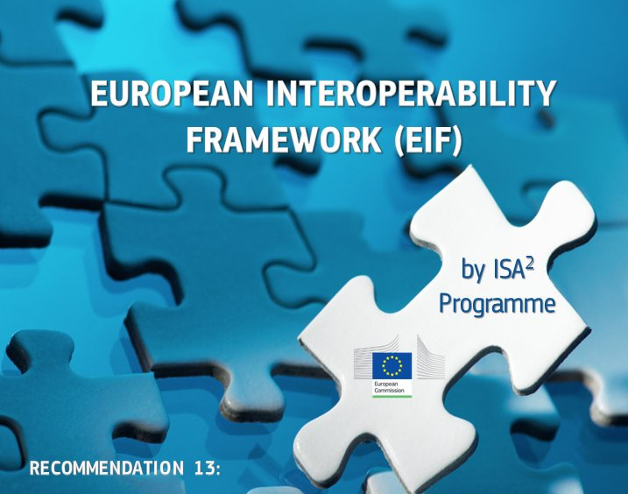

European context – Once Only
Open Standards for Linked Organisations

Slide 5
Interoperability levels
Legal interoperability aligned and digital friendly legislation
Political Context
Political, cultural and structural conditions
Organisational interoperability optimised processes by/for optimised data exchange
Semantic interoperability meaning, structure and appropriate use of information
Technological interoperability technical issues involved in linking computer systems
European Interoperability Framework (EIF)

Slide 6
Governance
INTERFEDERAL GOVERNANCE
GOVERNANCE
ICEG
REVIEW GROUP
COLLABORATION
THEMATIC WORKING GROUPS
STAKEHOLDERS
LOGICAL DATA MODEL
SHACL RULES
SPECIFICATION
DOCUMENTATION
GUIDANCE
DOCUMENTATION
VOCABULARY (RDF)
JSON-LD CONTEXT

Slide 7
Mission statement and roles
The review group ‘open standards’ has a permanent character and is responsible for the central coordination and follow-up of the work related to the standardisation of information.
Mission aligned to the existing collaboration agreement between the federal, regional and community authorities (dd. 2013-08-26).
The work is part of the standardisation of:
meaning of the information (semantic),
syntax (grammar) and technical standards for the exchange of the information
metadata for discoverability ('data on data’).
In addition, the working group monitors
mutual consistency of standards,
international standards that impact governments in Belgium
generic development and the change process.
The working group on data standards gathers on a regular basis.

Slide 8
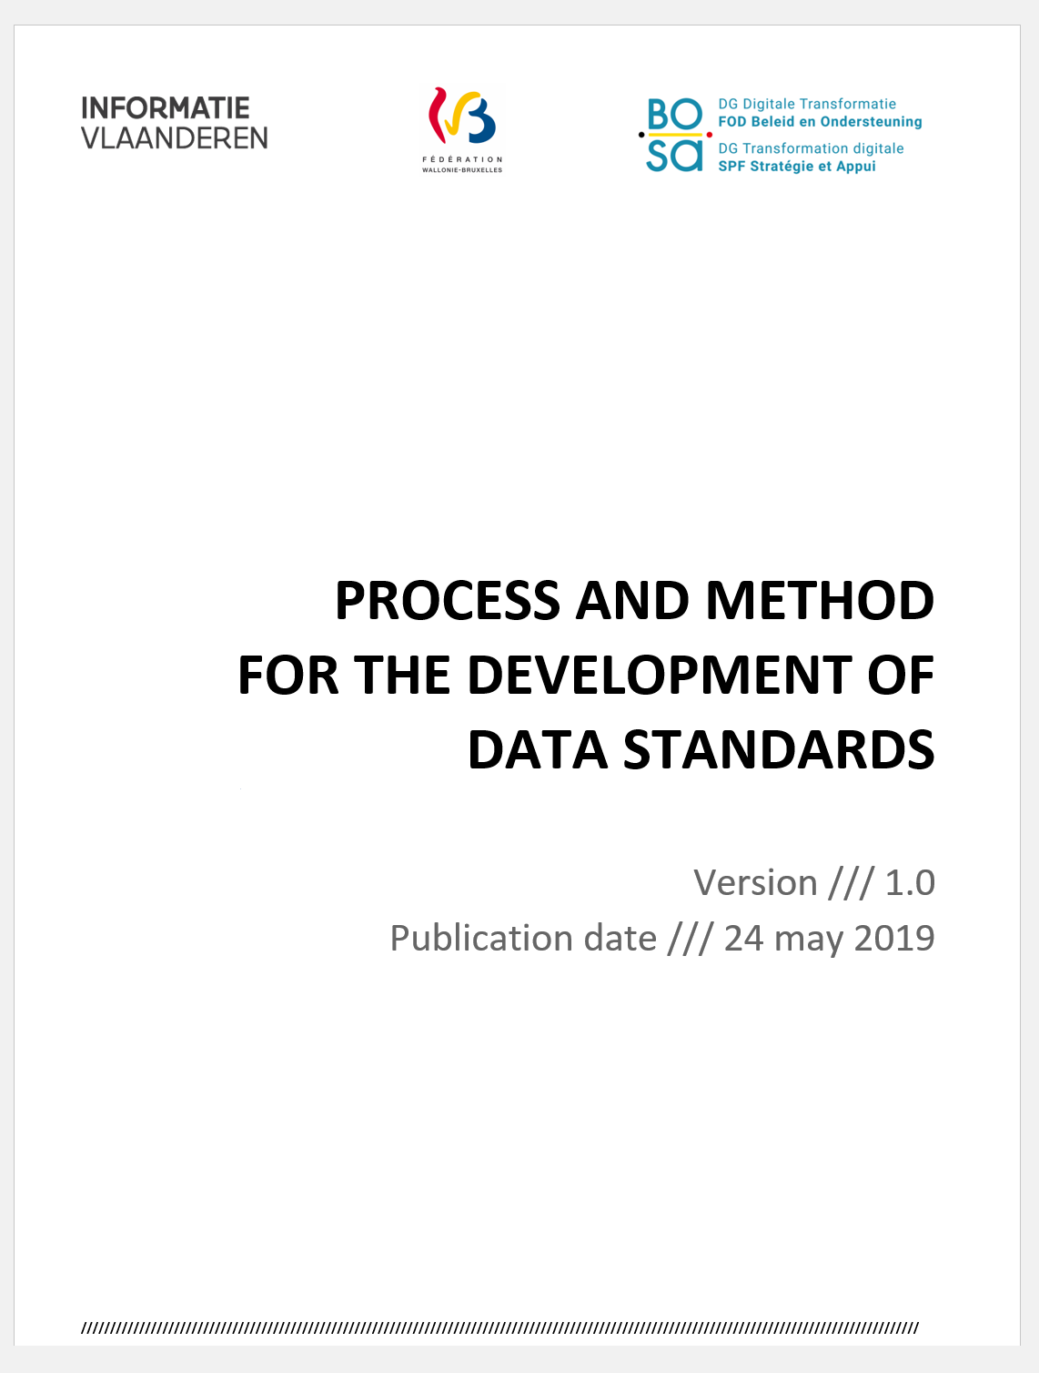
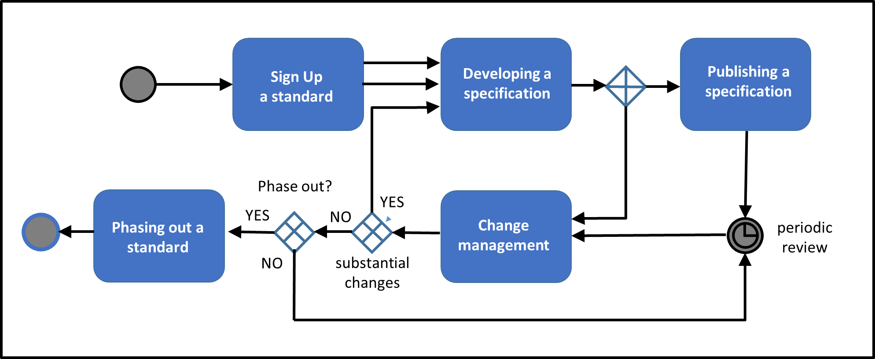
Governance: Process and method
Abstract: French, Dutch
Full paper: English
W3C, IEEE, IETF, IAB en ISA, Open Stand, OSLO

Slide 9
Agenda
Governance – request for approval Marc Bruyland
URI-standard – request for approval Raf Buyle
URI for enterprises/business units Bart Hanssens
New thematic on Education Thierry Brouwer
Digital Europe for All Marc Bruyland

Slide 10
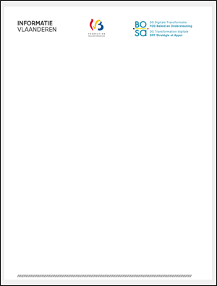

ICEG standard for URIs in data
ICEG STANDARD for URIs in data
Version /// 1.0
Date of Publication /// 11/02/2020
globally unique, persistent identifiers for data
Source: https://github.com/belgif/thematic/blob/master/URI/iceg_uri_standard.md

Slide 11
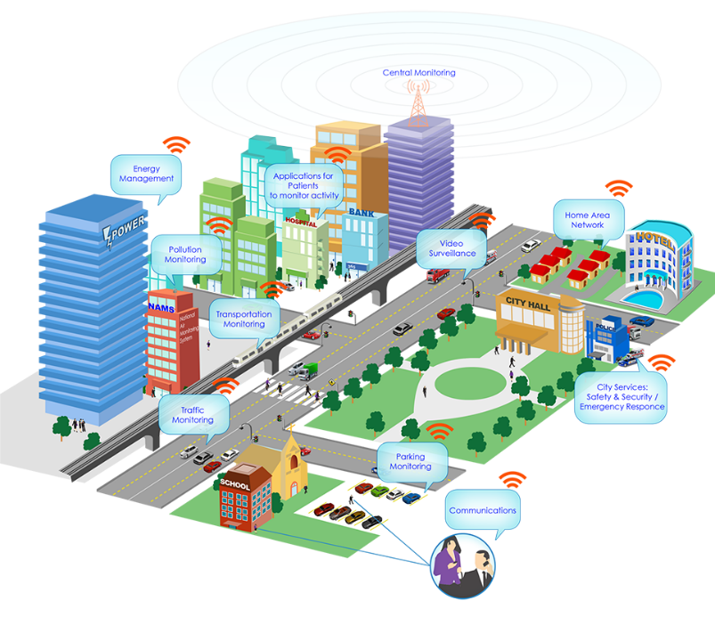
The Web as a blueprint
4 key principles
Persistent Identifiers: URIs
Dereferenceable HTTP URIs
Standardised Information (RDF)
Links to other information
Example
https://data.brussels.be/id/building/21322453123324555

Slide 12
Governance
Working group 1
Review group
Working group 2
Working group 3
ICEG
Public Review
11/10
8/11
22/11
31/1
19/2
Decision ICEG: ratifying the ICEG URI standard.

Slide 13
Agenda
Governance – request for approval Marc Bruyland
URI-standard – request for approval Raf Buyle
URI for enterprises/business units Bart Hanssens
New thematic on Education Thierry Brouwer
Digital Europe for All Marc Bruyland

Slide 14
URIs for organizations
Growing need to uniquely identify public administrations in linked data applications:
BOSA linked data registries (GDPR, AS, …)
Exchange of metadata in interfederal and EU context (SDG…) via ISA2 “Core Vocabularies”
Suggested solution
Use Crossroad Bank Enterprises as starting point for legal entities, without requiring changes to CBE itself
Create a decentralized mechanism for identifying parts of organizations that are not separate legal entities (e.g. BOSA DG DT)

Slide 15
Agenda
Governance – request for approval Marc Bruyland
URI-standard – request for approval Raf Buyle
URI for enterprises/business units Bart Hanssens
New thematic on Education Thierry Brouwer
Digital Europe for All Marc Bruyland

Slide 16
OSLO Education Data Vocabulary
An opportunity for Belgium & Europe

Slide 17

Digital Single Gateway
Regulation 2018/1724 of the European Parliament and of the council of 2 October 2018
Establish a Single Digital Gateway to provide citizens and businesses with easy access to high quality information, to efficient procedures and to effective assistance and problem-solving services.
The use of procedures by cross-border users and the implementation of the 'once-only' principle.
The reporting on obstacles in the internal market based on user feedback and statistics.

Slide 18

Cross-border students
European citizens have the right to live in the EU country where they are studying for the duration of your studies.
More and more students are exercising this right to study in several countries.

Slide 19

The need of european standards
These students need to pass on information about themselves, including their diplomas and training already completed, from one educational establishment to another and from one Member State to another.
This will require standards and nomenclatures to harmonise the structure and content of this information.

Slide 20



The belgian opportunity
In the field of higher education, the Flemish Agency for Higher Education, Adult Education and Grants (AHOVOKS) and the Academy of Research and Higher Education in wallonia-brussels federation (ARES) are actively collaborating in order to facilitate the exchange of information between Dutch-speaking and French-speaking higher education in Belgium.
This effort is already generating interest in other member countries.

Slide 21



ICEG Education vocabulary
Let us take advantage of these efforts and work together to achieve, for the exchange of educational data …
a Belgian ICEG standard,
a European standard.
This European standard could be ours.

Slide 22

Effort estimate
The semantics expert(s) will have to prepare an overview of information needs based on available documentation and organize a business and domain experts workshops, prepare documentation and reusable artefacts for the information model and publish them.
The technical expert will be responsible of the integration in the system of vocabularies.
Competence | Time (in mandays)
Semantics expert | 28
Technical expert | 4
Project manager | 6
TOTAL | 38
Cooperation is needed

Slide 23
Agenda
Governance – request for approval Marc Bruyland
URI-standard – request for approval Raf Buyle
URI for enterprises/business units Bart Hanssens
New thematic on Education Thierry Brouwer
Digital Europe for All Marc Bruyland

Slide 24
Digital Europe for All (DE4A)
What is DE4A ?
A project driven by a number of member states within the EU (a.o. BE)
A preparation for Single Digital Gateway (SDG)
3 pilots, 8 use cases
Architectural components
One of the pilots is about Education (study grants + certification of diplomas)
We need to describe the processes by April 2020
Are the following people the right persons to contact ?
Flemish community
LED ?
AHOVOKS ?
geert.mareels@vlaanderen.be
Tony Vanderstraete
French speaking community
@CEN : Aurélien Fiévez (aurelien.fievez@cfwb.be)
@ARES : Bénédicte Champagne (benedicte.champagne@ares-ac.be)
@AGE : Hicham Abbib (hicham.abbib@cfwb.be)
ahof@gob.brussels Alexander Hof
yasmine.ourari@ensemblesimplifions.be
German speaking community
bruno.hick@dgov.be

